Slide 1
Welcome
Maria Baltazzi, PhD, MFA
Happiness Explorer
Emmy-Winning TV Producer
Nautilus Book Award Winner
2x National Indie Excellence Book Award Winner
Author “Take a Shot at Happiness:
How to Write, Direct & Produce the Life You Want”

Slide 2
Being Happy …or Happier
An inner state of peace and contentment when your thoughts and emotions align with your values, holding your wellbeing in good stead even when life gets challenging.

Slide 3
“Be the heroine (or hero) of your life, not the victim. Because you don’t have the alibi my class had—this is one of the great achievements and mixed blessings you inherit.”
~ Filmmaker Nora Ephron

Slide 4
Happiness Continuum
Unhappy
Low, dispirited
Happy
Inner state of peace, contentment and
wellbeing

Slide 5
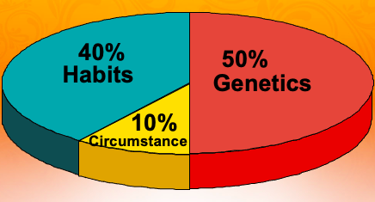
Happiness Set Point
Genetics and learned tendencies remain at a certain level of happiness
Can be adjusted and raised by intentional and consistent happiness-boosting activities
Source: Happiness Researcher Dr. Sonja Lyubomirsky, UC Riverside

Slide 6
Kevin
Live Long and Prosper

Slide 7
“Happiness is resilience wrapped in hopeful packaging. ”
~ Author Maria Baltazzi, PhD, MFA

Slide 8
Happiness Essentials
Virtue and Qualities of Happy People
Virtues being your personal or moral standards: Faith, Love, Gratitude, Forgiveness, Peace
Qualities being the attributes or characteristics you value: Health, Detachment, Abundance

Slide 9
Jesus Prayer: Prayer of the Heart
Lord
Jesus Christ,
Son of God,
have mercy on
me, a sinner.
(Alt., please guide me.)

Slide 10
Thought Stopping
Clap your hands
Snap a rubber band on your wrist
Say: STOP IT
Snap your fingers
Source: Cognitive Behavior Therapy (CBT)

Slide 11
Contraction Expansion
Expansion
Happiness
Love
Optimism
Flow
Acceptance
Vitality
Ease
Wellbeing
Connection
Feeling Good
Contraction
Unhappiness
Fear
Pessimism
Constriction
Resistance
Low Energy
Disease
Malaise
Separation
Feeling Bad
Source: Happiness Author Marci Shimoff

Slide 12
Savoring the Good
Look for positive moments throughout your day
Pause 20 to 30 seconds to savor the moment
Source: Neuropsychologist Dr. Rick Hanson

Slide 13
Three Happiness Habits
Deep breathing along with prayer and meditation
Thought Stopping
Savoring the good

Slide 14
“Life is like a film camera. Focus on what is important, capture the good times, develop from the negatives, and if things do not work out, take another shot.”
~ Take a Shot at Happiness:
How to Write, Direct & Produce
The Life You Want

Slide 15
Stay in Touch
IG, FB, InsightTimer, LinkedIn: @mariabaltazzi
IG, FB: @sojourntohappiness
My Gift: Get daily happiness advice sent directly to your phone. Just text HAPPY to 844-866-2192
Maria Baltazzi, PhD, MFA

