Slide 1
FAMILY CAREGIVING: Our Community’s Journey to Understanding, Compassion and Hope
ANNA VEDOURAS, J.D.
REV. DR. HARRY PAPPAS
PAULETTE GEANACOPOULOS, LMSW
ELENI CONSTANTINIDES (NJ) &
LISA XANTHOS (SF)
Co-Chairs, National Social Services Committee
Greek Orthodox Ladies Philoptochos Society | Department of Social Services
Convention 2024 | July 2, 2024 | 12:30pm – 2:00pm

Slide 2
To educate our community about the many challenges faced by family caregivers
To motivate our Philoptochos Chapters and Metropolises to respond to the needs of family caregivers within their own communities.

Slide 3
FAMILY CAREGIVING IS . . .
A SOCIETAL ISSUE:
53 million caregivers in the United States
Most caregivers are women
Provide 25+ hours of caregiving per week
They are caregivers for 4 – 6 years
Spend about $7,200/ year in out-of-pocket costs

Slide 4
FAMILY CAREGIVING IS . . .
A PHILOPTOCHOS ISSUE:
A significant number of Philoptochos members were, currently are or will be caregivers in the future.
As more and more people live longer, still others are likely to need caregiving going forward.
Forewarned is forearmed

Slide 5
CAREGIVING IN A GREEK ORTHODOX FAMILY
Anna Vedouras, J.D.

Slide 6
Anna Vedouras, J.D.
Anna Vedouras is a second generation Philoptochos Board member who has a strong commitment to service. She is an attorney who served in Federal service for over 33 years before her retirement in 2022. She specialized in Labor and Employment Law for over 20 years; managed various departments in operations, and her in last position was appointed to the position Executive Director of the Cleveland Federal Executive Board. Anna Vedouras has been a member of the Sts. Constantine & Helen, Cleveland Heights, Ohio, Philoptochos for over 30 years. She has served on its Boards various times in different roles. Anna’s commitment to service has reached deep into the greater Cleveland Community. She has served on numerous non-profit boards in various positions including: The Cleveland PlayHouse, The Center for the Prevention of Domestic Violence, Museum of Contemporary Art, The Cleveland International Film Festival (during which she also served as President), FOCUS North America and St. Herman’s House of Hospitality. Anna was appointed to the National Board of Philoptochos in 2022 by Archbishop Elpidophoros. She has served on the Pittsburgh Metropolis Philoptochos board since 2020 and serves as the vice president of both the Metropolis Philoptochos and the Philoptochos of Sts. Constantine & Helen, Cleveland Heights, OH. She and her husband Jack Ramsey (currently serving on the parish council) are active members of Sts. Constantine & Helen Cathedral, Cleveland Hts., Ohio. When not volunteering, caregiving or supporting their family by attending events for their five grandchildren Anna and Jack enjoy numerous passions including traveling and long-distance hiking. Anna received her B.A. from the University of Michigan, Ann Arbor, and her J.D. from Cleveland State University. She attended the Public Leadership and Policy program at the Harvard Kennedy School.

Slide 7
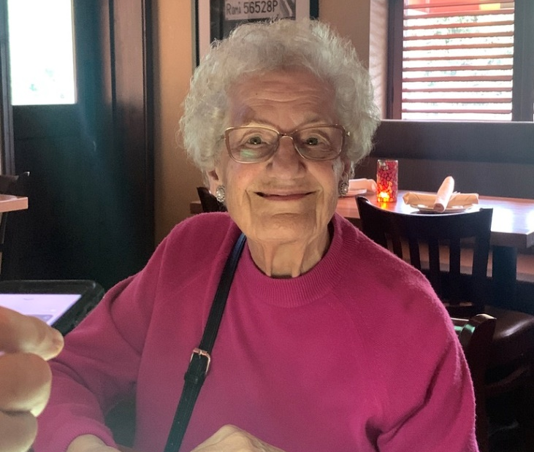
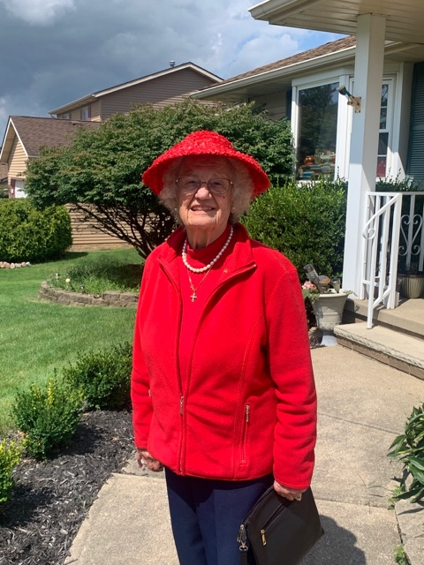
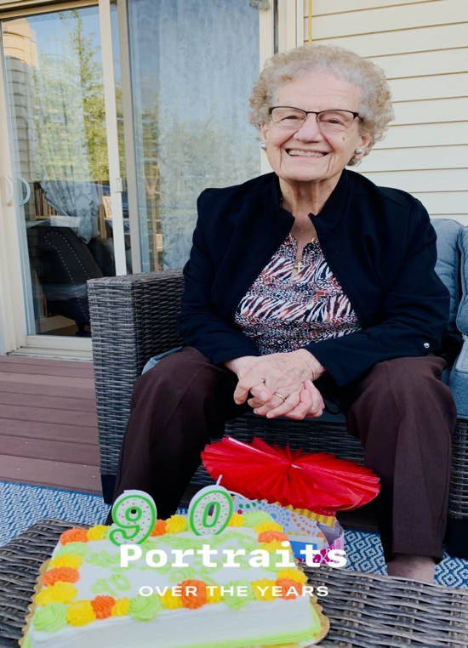
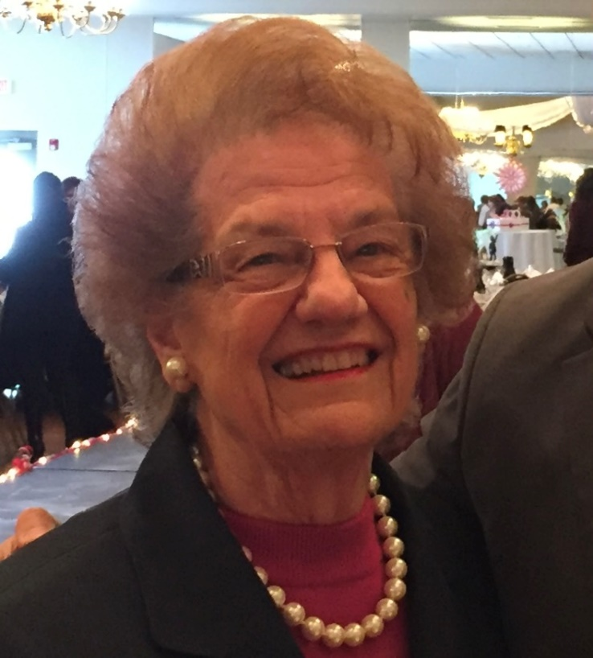
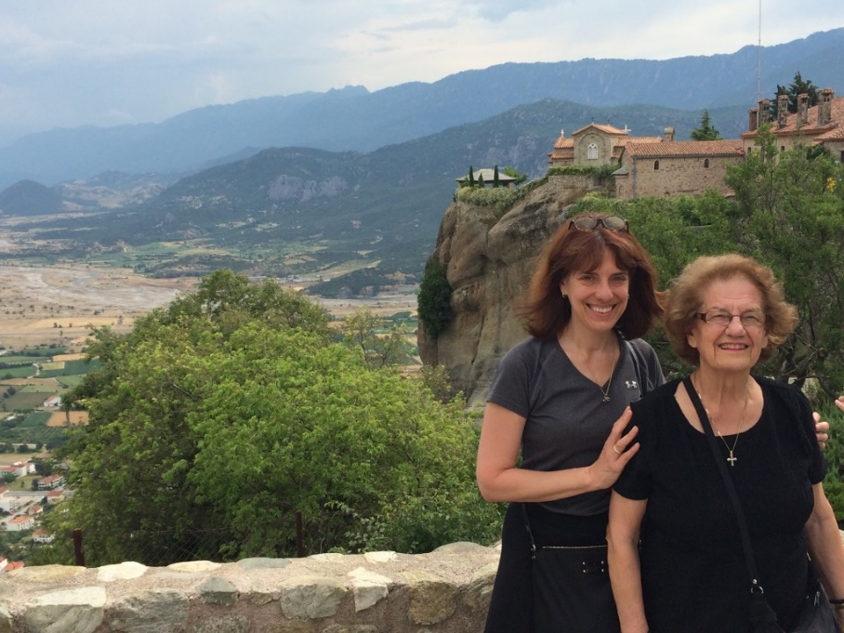

Slide 8
Try to look ahead:
What are the responsibilities of caregivers?

Slide 9
What is Caregiver Burnout?
Causes of caregiver burnout
may include…
Tips to manage caregiver stress

Slide 10
Nationwide Caregiver Resources:
ELDERCARE LOCATOR /
AREA AGENCIES ON AGING (AAA)
Find your local Office for the Aging
Connect to local programs, services, resources (by zip code)
Eldercare.acl.gov/Public/About/Index.aspx 1.800.677.1116
ALZHEIMER’S ASSOCIATION
alz.org | 24/7 Helpline 1.800.272. 3900
State-by-state lists of caregiver services:
AARP:
https://www.aarp.org/caregiving/local/info-2021/state-caregiver-resources.html
FAMILY CAREGIVER ALLIANCE https://www.caregiver.org/connecting-caregivers/services-by-state
AGING LIFE CARE ASSOCIATION
Certified geriatric care managers | https://www.aginglifecare.org

Slide 11
National Academy of Elder Law Attorneys
• https://www.naela.org
MEDICARE / MEDICAID
• Longtermcare.gov
Medicare Rights Center
Ensures access to affordable health care for older adults and
people with disabilities through
•COUNSELING
•ADVOCACY
•EDUCATIONAL PROGAMS
•POLICY INITIATIVES
• https://www.medicarerights.org
BenefitsCheckUp – NCOA
Free, confidential, online screening tool from the National Council on Aging
that helps older adults and people with disabilities find out if they may be eligible
for public and private benefits that can help pay for housing, utilities, food,
transportation and more.
• www.benefitscheckup.org
Nationwide Caregiver Resources

Slide 12
POLICY INITIATIVES TO EASE THE BURDEN OF CAREGIVERS
Paulette Geanacopoulos, LMSW

Slide 13
Paulette Geanacopoulos, LMSW
Director, National Philoptochos Department of Social Services.
Paulette Geanacopoulos aids Orthodox Christians across the USA to address the many human service and financial challenges they face. She co-leads nationwide Caregiver Support Groups for Orthodox Christians, provides training to Philoptochos affiliates to support their social services efforts, and participates in Archdiocesan ministries addressing various societal issues. Prior to Philoptochos, Paulette held leadership roles in government and nonprofit organizations serving vulnerable populations including older adults, victims of domestic violence, mentally ill homeless adults, incarcerated youth and substance abusers. She has taught Social Welfare Policy at the Fordham University School of Social Services, Hunter College/CUNY Department of Urban Affairs and Planning, and the New York University Silver School of Social Work. She has served on the executive boards of nonprofit organizations in New York and New Jersey and has written publications distributed within and outside the Greek American community. She holds a BA in Political Science from the City College of New York/CUNY, and an MSW (Macro Concentration) from the Silberman School of as a recipient of a NIMH Cross Cultural Cross Regional Drug Abuse Grant, and shSocial Work at Hunter College, NY. She studied at the Puerto Rico Learning Center, Ponce, PR e received her certification as a Mediator in Community Conflict Resolution. Paulette’s home parish is the Cathedral of St. John the Theologian, Tenafly, NJ where she is a member of the Cathedral’s St. Philothea Philoptochos Chapter.

Slide 14
Many policy initiatives differ from state-to-state
and have different eligibility requirements.
Research which may be available to you and your situation.
FMLA: Family Medical Leave Act Up to 12 weeks unpaid, job-protected leave | Can take in increments of weeks, days or hours.
For information:
National Conference of State Legislatures: www.ncsl.org
MILITARY FAMILY CARE LEAVE
p to 26 weeks in 12-month period to care for servicemember or veteran:
For information: Law for Veterans: https://lawforveterans.org/
PAID FAMILY LEAVE
Only 13 states and District of Columbia have mandatory paid family leave systems.
For information: Bipartisan Policy Center:
https//:bipartisanpolicy.org/explainer/state-paid-family-leave-laws-across-the-u-s/

Slide 15
Caregiving and Taxes
CREDIT FOR CARING ACT (tax credit)
Bipartisan bill introduced in Congress
Lowers amount person pays in income tax. For information:
AARP: www.aarp.org/caregiving/financial-legal/info-2024/credit-caring-act-html
CAREGIVER TAX DEDUCTIONS
For information: National Academy of Elder Law Attorneys www.naela.org
CLAIMING LOVED ONE AS A DEPENDENT
www.irs.gov/faqs/irs-procedures/for-caregivers/for-caregivers

Slide 16
GET PAID TO CARE OF A FAMILY MEMBER If the care recipient has Medicaid or is Medicaid eligible, ten states will pay a family member or other designated person to provide caregiving. The programs have different names in different states. In NYS, it is called “Consumer Directed Personal Assistance Program” (CDPAP), other states it is a Medicaid Waiver, yet others In-Home Supportive Services. To find out if your state offers this assistance, and the name of your state’s program: Senior Home Companions • https://seniorhomecompanions.com/what-states-pay-you-to-take-care-of-a-family-member/ __________________________________________________ HR / EMPLOYER POLICIES To learn about initiatives being promoted regarding caregiving and the workplace such as gender -neutral policies and flexible work schedules: A Better Balance: www.abetterbalance.org

Slide 17
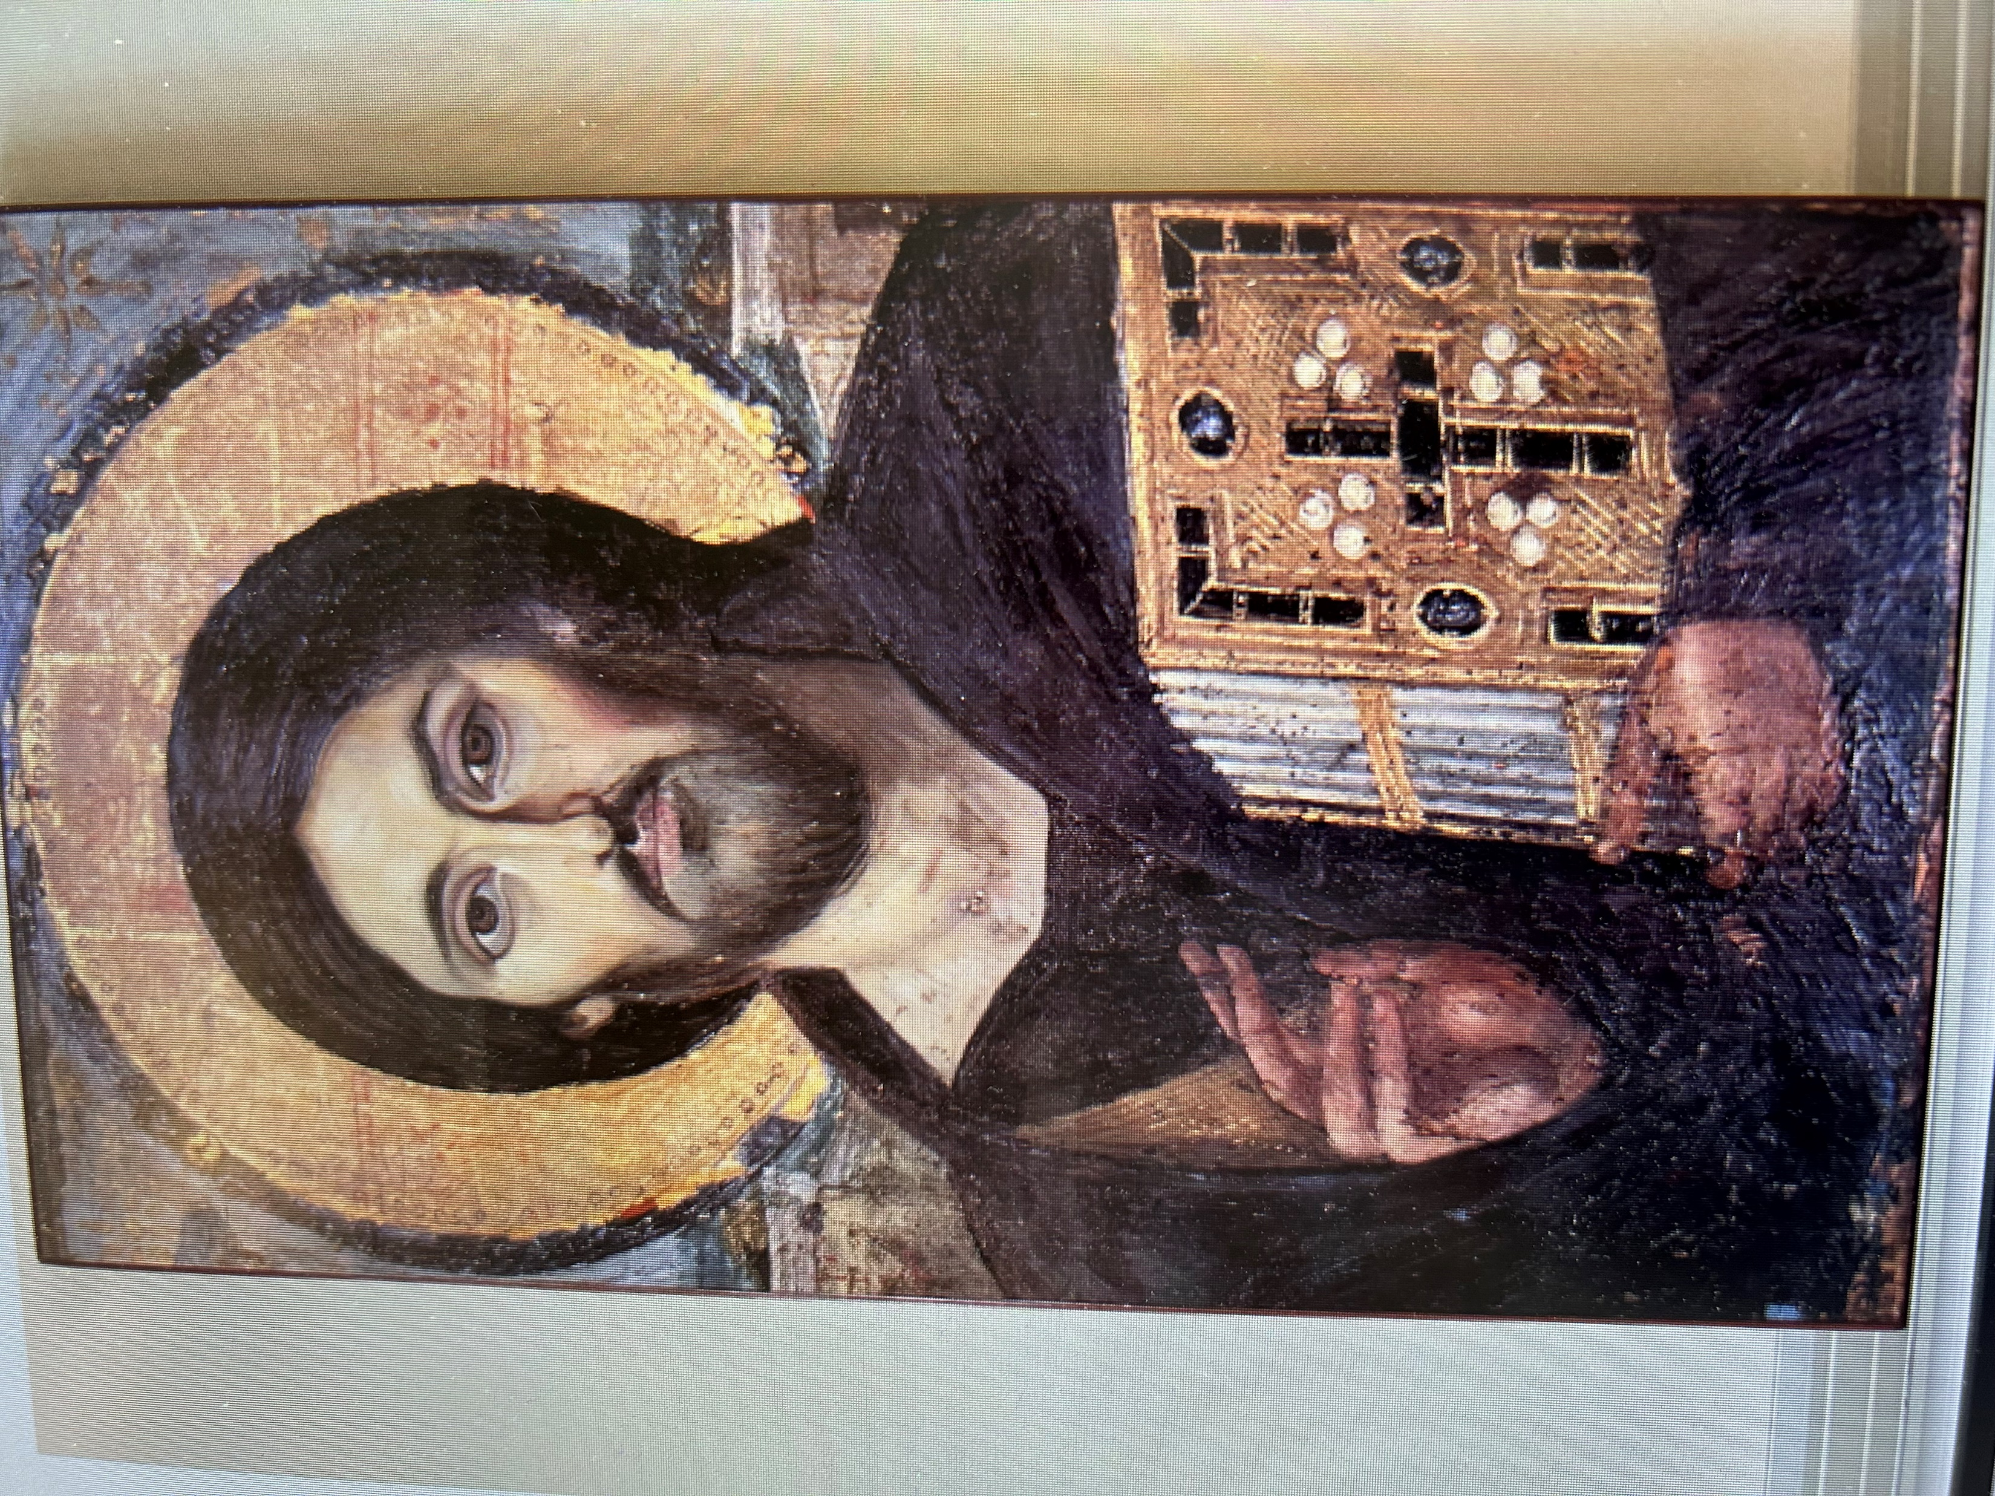
CREATING A CAREGIVER-FRIENDLY CHURCH ENVIRONMENT
Rev. Dr. Harry Pappas

Slide 18
Rev. Dr. Harry S. Pappas
Presiding Priest, Archangels Greek Orthodox Church, Stamford, CT
A native of St. Louis, Fr. Harry grew up at St. Nicholas Greek Orthodox Church. He is a graduate of Davidson College, Holy Cross School of Theology, Harvard Divinity School, and Yale University, where he earned a Ph.D. in the Old Testament. Along with 39 years pastoral experience in various parishes (including Nashville, Minneapolis, and New Rochelle), he has taught courses in Biblical Hebrew at Yale; Old Testament, Pastoral Theology, Parish Administration, and Preaching at St. Vladimir’s Seminary and Holy Cross School of Theology. Fr. Harry has been in the mission field (short term in Albania, Mexico & Guatemala), ministry to the homeless (New York City and Stamford), a member of the Orthodox Theological Society of America (OTSA) and the International Orthodox Theological Association (IOTA), as well as a variety of local ecumenical and interfaith organizations. He was a past Board member of Project Mexico and the Collegeville Institute for Ecumenical & Cultural Research, and currently serves on the Advisory Boards of IOTA and the Huffington Ecumenical Institute (HEI) at Holy Cross. Fr. Harry has been married to Kerry (Kaloudis) for 42 years since they met at Seminary; they are blessed with three children and six grandchildren. He is a practitioner of contemplative prayer, and enjoys reading, physical exercise, nature, and good movies.

Slide 19
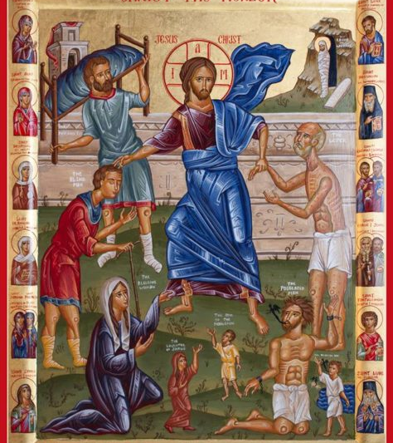
CHRIST THE HEALER

Slide 20
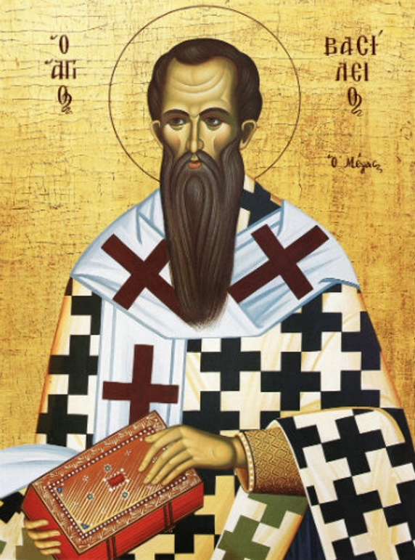
ST. BASIL THE GREAT

Slide 21
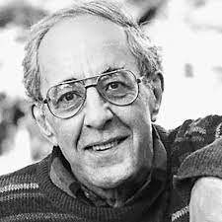
FR. HENRI NOUWEN
(died 1996)

Slide 22
Lord of the Powers, be with us;
for in times of distress,
we have no other helper but you;
Lord of the Powers, have mercy on us!
Κύριε τῶν Δυνάμεων, μεθ' ἡμῶν γενοῦ·
ἄλλον γὰρ ἐκτός σου βοηθόν,
ἐν θλίψεσιν οὐκ ἔχομεν,
Κύριε τῶν Δυνάμεων, ἐλέησον ἡμᾶς.

Slide 27
SUPPORT GROUPS

Slide 29
Confidential conversation

Slide 30
RESURRECTION ODE
Having beheld the Resurrection of Christ, let us worship the holy Lord Jesus, the only sinless one. We venerate your Cross, O Christ, and we praise and glorify your Resurrection. For you are our God, we know no other than you, and we call upon your name. Come all you faithful, let us worship the holy Resurrection of Christ. For behold, through the Cross, joy has come into all the world. Ever blessing the Lord, let us praise his Resurrection. For by enduring the Cross for us, he has destroyed death by death!

Slide 31
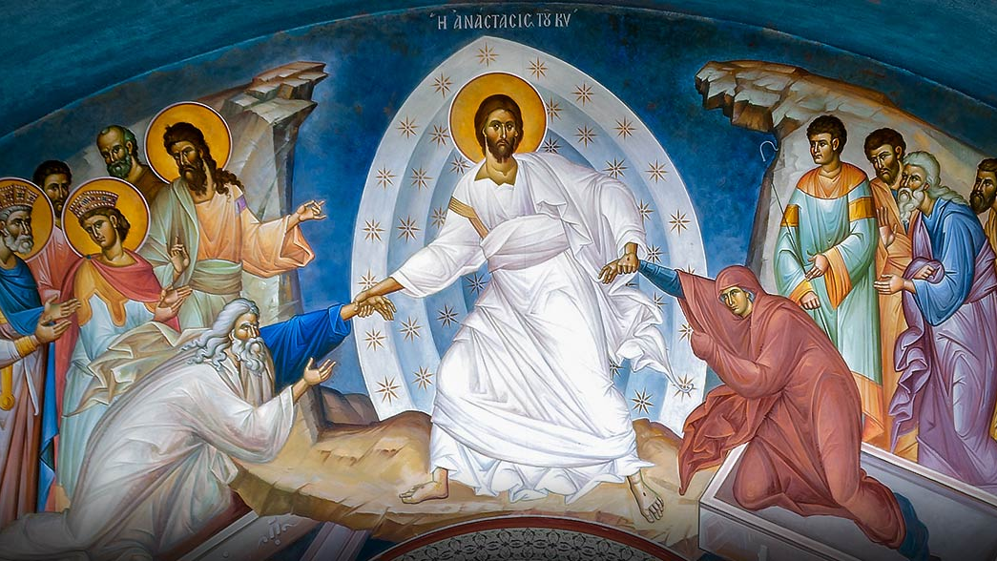

Slide 32
A CALL-TO-ACTION
When you return home to your parishes,
Philoptochos Chapters and Metropolises,
are there actions you can take
– regardless how small –
to respond to the needs of local caregivers in your own communities?

